Slide 1
Mobbing Basics

Slide 2
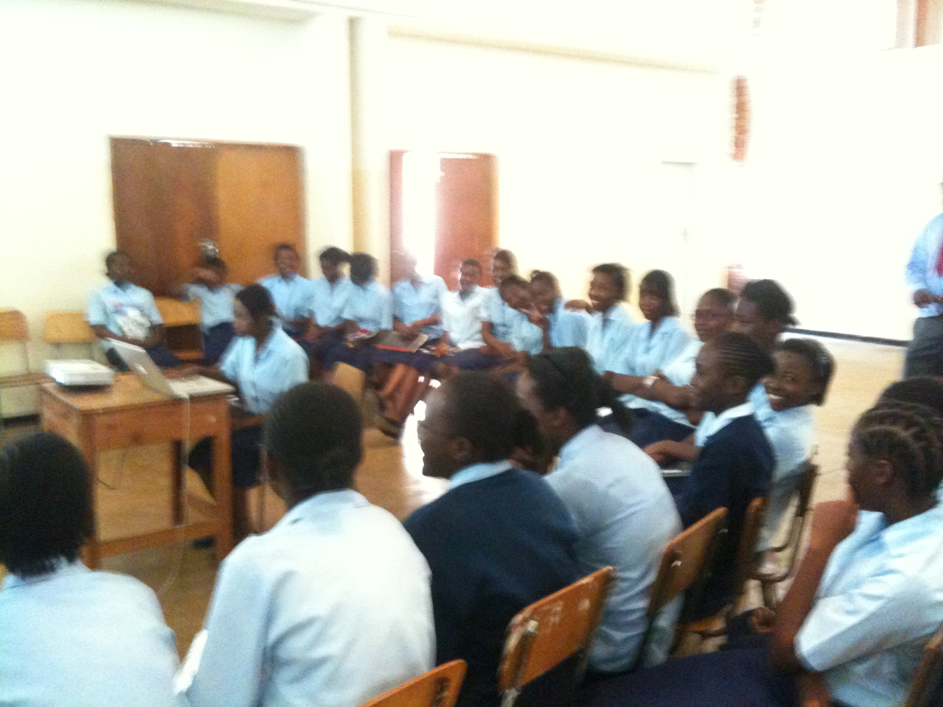
Notes:
Mobbing is a team working together, with 2 people at a time having significant roles.
In person, you can see who is typing, who is giving instructions, and how many people until your turn
In this picture…
Sadly no such help in the virtual world
So we will use other things to achieve this

Slide 3
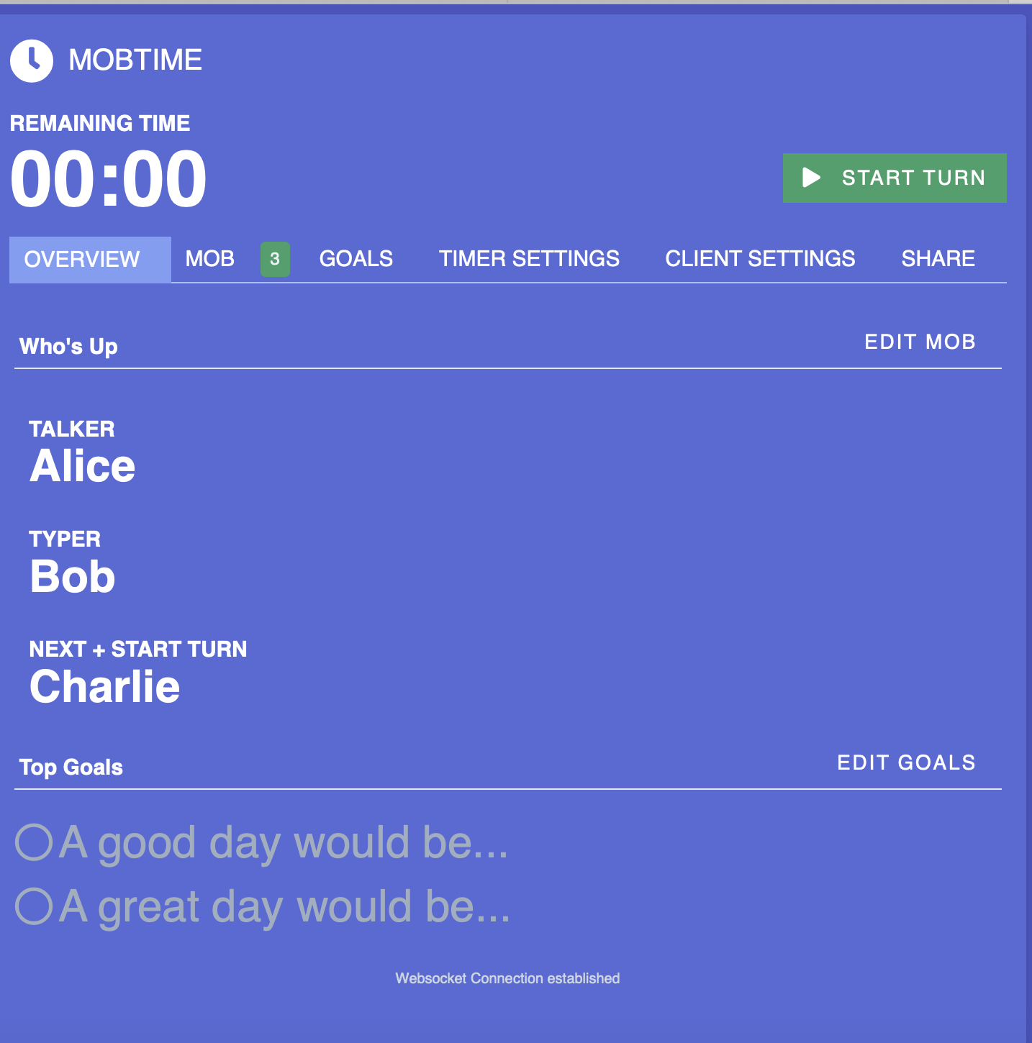
< Alice: I’m Talking
< Bob: I’m Typing
< Charlie: I’m Next and starting timer
Notes:
This is MobTimer
We’ll put everyone's name in it
Then we will call out 3 things
“No thinking at the keyboard”
Person talking is doing all the thinking – you can ask for help
Next – makes sure you are aware you are next
we will rotate every 3 minutes

Slide 4
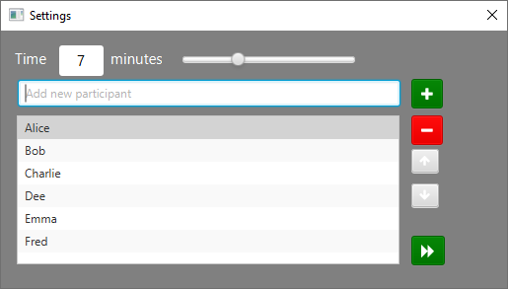
< Bob: I’m Typing
< Charlie: I’m Talking
< Dee: I’m Next
Notes:
When we advance, it moves down

Slide 5
< Charlie: I’m Typing
< Dee: I’m Talking
< Emma: I’m Next

Slide 6
Next, Talking, Typing
Remember the person before you
Notes:
Here are the two things you need to remember
We will practice it now
Let’s enter the names
And practice

Slide 7
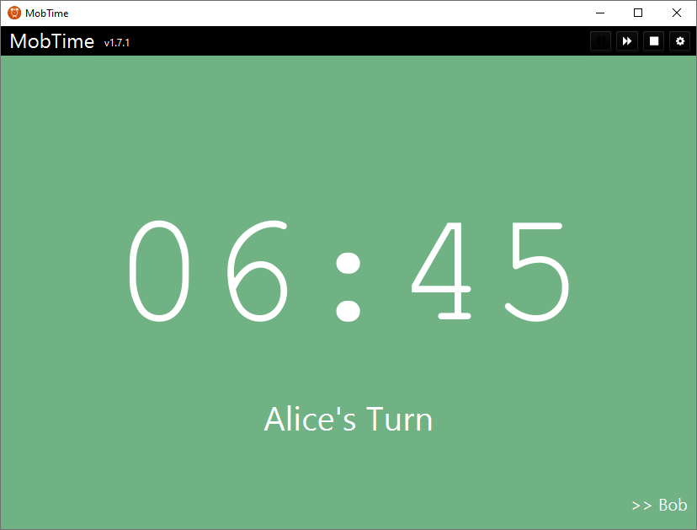
< Alice: I’m Typing
< Bob: I’m Talking
< Charlie: I’m Next
Notes:
Explain the red

Slide 8
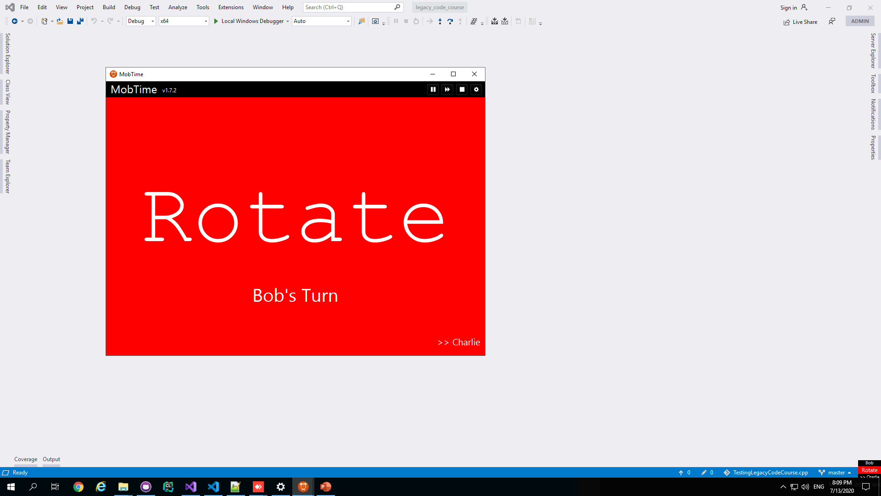

Pause
Main
Ding Dong
Mini
* Bell by richad from the Noun Project
Notes:
You’ll hear doorbell sound when turn is done
Notice the mini-window– clicking on that brings up main window
Can click anywhere in the main window to start the turn
Notice the pause – we use that when we need to talk

Slide 9
Kindness Consideration & Respect
Notes:
Kindness: how we talk to each other. Don’t have to agree, but need to disagree kindly
Consideration: is about listening to each other. Can be very hard, we often don’t practice. Can be hard if you think they are telling you something that is wrong
Respect: 2 –fold. Respect each other, but also respect the code that we are working on. Goal is to improve the code, but that doesn’t mean we have to disrespect it. It was written by someone with the knowledge and pressures and stress at the time.

Slide 10
Intention Location Details
Notes:
Finally, we don’t have practice going from head to keyboard from someone else’s hands to keyboard.
Start by saying intention – what to happen.
If that is not enough, say the location, e.g. line blah
If that is not enough, tell them what to type.
Story
Notice: if we follow this, always talk at appropriate level. Giving enough info.
Clue to move to next level is when you see hesitation, inaction or confusion.
Often need less detail later on.

